Slide 1
QUIZ GAME
Simple quiz game for interested ones
-BY GROUP MINTERS

Slide 2
GROUP MINTERS
Nitesh Kumar Shah (Leader) | All Rounder.
Aryan Rijal | Coder and contributor in Proposal.
Bishal Bista | Coder and contributor in Presentation.
Prasanna Pradhan | Coder and Designer of Presentation.

Slide 3
Table of contents
01
About Quiz
02
C
Introduction of Quiz, Purpose of quiz
Introduction of C, Key features and applications
03
Function Used
04
Output &Conclusion
Each and every functions and structures of C used in this program.
Simple layout of code , its output and conclusion.

Slide 4
INTRODUCTION OF QUIZ
01
What is quiz?
A quiz is a short assessment or a game designed to test knowledge, skills, or abilities.
It typically consists of a series of questions with multiple-choice answers, true/false, or open-ended formats.

Slide 5

PURPOSE OF QUIZ
Educational Tool: Helps in learning and reinforcing knowledge.
Assessment: Evaluates understanding of a subject or topic.
Engagement: Makes learning interactive and fun.
Competition: Encourages healthy competition among participants.
Feedback: Provides immediate results and feedback

Slide 6

INTRODUCTION OF C
02
What is C?
C is a general-purpose, procedural programming language.
Developed by Dennis Ritchie in 1972 at Bell Labs.
Known for its efficiency, flexibility, and portability.
Often referred to as the "mother of all programming languages

Slide 7
-Key Features
-Applications
Procedural Language: Follows a step-by-step approach to solve problems.
Structured Programming: Supports functions, loops, and conditionals.
Low-Level Access: Provides direct access to memory and hardware.
Portability: Code written in C can run on different platforms with minimal changes.
Rich Library: Comes with a wide range of built-in functions.
System Programming: Used to develop operating systems (e.g., UNIX, Windows).
Embedded Systems: Ideal for programming microcontrollers and IoT devices.
Game Development: Used in game engines and graphics programming.
Compiler Design: Basis for developing other programming languages.
Database Systems: Used in database management systems like MySQL

Slide 8
FUNCTIONS USED
02
Library Functions Used
Data Structures
Key Concepts and Functions

Slide 9
Library Functions
Data Structures
Standard Input/Output Functions (stdio.h)
String Manipulation Functions (string.h)
Memory Management Functions (stdlib.h)
Random Number Generation (stdlib.h & time.h)
Character Handling (ctype.h)
File handling (stdio.h)
Question Structure
LeaderboardEntry Structure

Slide 10
Key Concepts and Functions
Program Flow
Dynamic Question Loading
Shuffling Questions
Leaderboard Management
Input Validation
File Handling
Main Menu
Quiz Play
Leaderboard
Exit

Slide 11
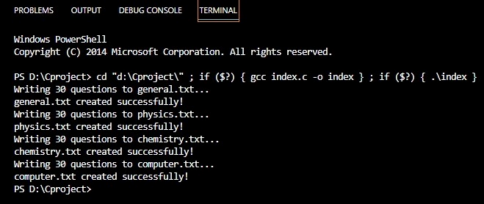
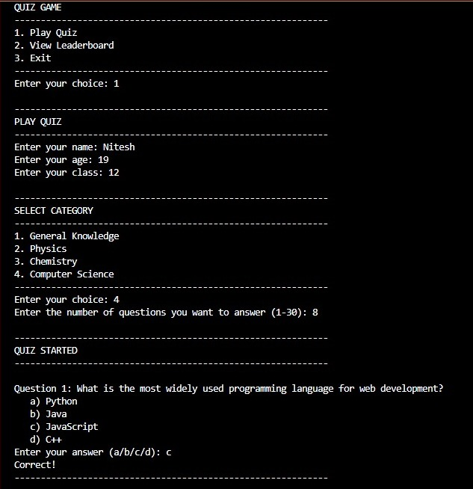
Output
04

Slide 12
CONCLUSION
04
The Quiz Game Program is a C-based application that allows users to test their knowledge across categories like General Knowledge, Physics, Chemistry, and Computer Science. Users can choose the number of questions (up to 30) and enjoy a randomized quiz experience, thanks to the Fisher-Yates algorithm. The program features a leaderboard to track top scores and includes robust input validation to ensure smooth functionality. It uses file handling to load questions and save leaderboard data, along with structures like Question and LeaderboardEntry for efficient data organization.
By combining essential programming concepts such as file handling, data structures, and randomization, the program demonstrates the versatility of C. It provides an interactive and engaging quiz experience, making it suitable for both learning and entertainment. This project highlights how C can be used to create practical and functional applications.

Slide 13
Thanks!
Does anyone have any questions?
TEAM MINTERS

